Slide 1

Welcome to the world!
Objectives
Explore the World!
Use the “pan”, “zoom in/out” and “rotate” gestures to see more of the world.
Build 5 Houses
Add 5 houses to the game which will spawn NPCs.
Get into Build mode by saying “Build”. Move your hand around to choose a position to place the building.
The building is highlighted green if it can be placed there and red if not. Make a fist to build. Say “Exit” to resume normal play.

Slide 2



Lets get Started
Say to cast power
Objectives
“Hey!” - Bless a random NPC and make them immune to attack
Change mood to change world weather.
Shower your blessings on the world!
Try to scare people!
Fill XP Bar
“Boo” - Scare away a random NPC
“Thunderclap” - Infuriate the clouds!

Slide 3



More Powers!!
Point and speak to cast
Objectives
“Lightning” – Shoots a white luminous lightning bolt from the heavens.
Kill All Zombies by using all available powers
Explore all new powers!
Fill XP Bar
“Fireball” – Catapult glowing embers twirled in a fiery ball.
“Tornado” – Toss your enemies into a whirlwind and make them fly away!

Slide 4
Survival Mode
This is the final test of your competence as an Omnipotent. Dinosaurs and spiders have joined forces with the zombies! These creatures are more powerful and take more tenacity to kill
Evil dinosaurs can now summon their powers to shoot fireballs from the sky. A region is highlighted on the ground which indicates the area of impact of the incoming ball. Enable the newly unlocked “Shield” and use your hand to bounce off the balls
You now also have the power to “Reach” to the NPCs and play around with the NPCs which can also be used to push them to safety, away from attacks
Objectives: Survive the time attack!

Slide 5
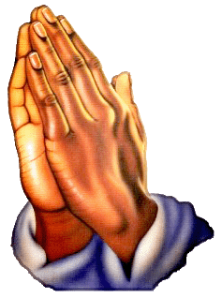

Free Play
Congratulations! You have proven yourself again as “The Omnipotent”!
These are one of two end-games you can chose from:
“Hand of God”: This is a monument dedicated to you! This is your reflection in the world which will take care of it from now.
“Sucker Punch”: It seems evil has taken over you. Take out all your anger on the world! Blow the world to pieces at your whim. See what happens!

